Slide 1
💾
MEMORY MANAGEMENT
A Complete Seminar on How Computers Handle Memory
Computer Science | Operating Systems

Slide 2
01 | What is Memory?
Definition
Memory Hierarchy
Memory is the part of a computer that stores data and instructions so the CPU can use them.
CPU Registers
Fastest
💡 Real-World Analogy
Cache Memory
Think of memory like a desk — RAM is where you keep what you're working on now, and the hard disk is your filing cabinet for finished work.
Very Fast
RAM (Main)
Stores currently executing instructions
Fast
Provides fast data access for the CPU
SSD / HDD
Holds OS and user programs simultaneously
Slow

Slide 3
02 | What is Memory Management?
Memory management is the process of allocating, tracking, and freeing memory for programs in a computer system.
📦
♻️
📊
🛡️
Allocation
Deallocation
Tracking
Protection
Gives memory to processes.
Decides how much and where in RAM each process is placed.
Frees memory after use.
Returns the block to the free pool for future processes.
Keeps record of used & free memory.
Uses tables or bitmaps to track every memory block.
Prevents one process from accessing another's memory.
Ensures isolation and security.

Slide 4
03 | Why is Memory Management Needed?
❌ WITHOUT Memory Management
✅ WITH Memory Management
Programs may overwrite each other
Efficient use of memory
Process A can corrupt Process B's data.
Each process gets exactly the memory it needs.
Memory gets wasted
Safe execution of programs
Unused blocks never freed — memory leaks.
→
Processes are isolated — crashes don't spread.
System may crash
Better performance
Corruption leads to instability and crashes.
Faster allocation and smart memory reuse.

Slide 5
04 | Types of Memory
PRIMARY MEMORY
SECONDARY MEMORY
Fast, directly accessible by CPU
Permanent, slower, larger capacity
RAM
Random Access Memory
HDD
Hard Disk Drive
Stores currently running programs & data
Volatile — data lost on power off
Magnetic spinning platters, large capacity (TBs), affordable
ROM
Read-Only Memory
SSD
Solid State Drive
Stores permanent boot instructions (BIOS)
Non-volatile — retained without power
Flash memory — no moving parts
Much faster than HDD
Cache
Ultra-Fast CPU Buffer
USB
Pen Drive / USB Flash
Extremely fast, located near CPU
Stores frequently accessed data (L1/L2/L3)
Portable flash storage
Plug-and-play, used for data transfer

Slide 6
05 | Virtual Memory
Virtual memory is a technique that allows execution of large programs by using secondary storage as an extension of main memory. The OS maps virtual addresses to actual RAM.
How Virtual Memory Works
▶ Run Large Programs
Program
(Large)
RAM (Physical)
Execute programs bigger than physical RAM using disk.
→ OS Maps →
Swap Space
(Disk)
▶ Process Isolation
Each process has its own private virtual address space.
Paging is the technique that makes virtual memory possible.
Each process gets a virtual address space (e.g., 4GB on 32-bit). The OS uses a Page Table to translate virtual → physical RAM addresses. Programs think they have dedicated memory.
▶ Efficient Multitasking
Multiple processes share RAM without interfering.

Slide 7
06 | Paging Technique
Paging divides logical memory into fixed-size pages and physical memory into equal-size frames. The OS maps pages → frames via a Page Table.
Logical Memory
Page Table
Physical Memory
Page 0
Page 0 → Frame 2
Frame 0 ← Page 1
Page 1
Page 1 → Frame 0
Frame 1 ← Page 3
Page 2 → Frame 5
Page 2
Frame 2 ← Page 0
Page 3 → Frame 1
Page 3
Frame 3 ← Page 5
Page 4 → Frame 4
Page 4
Frame 4 ← Page 4
Page 5 → Frame 3
Page 5
Frame 5 ← Page 2
✅ Key Benefit: Eliminates external fragmentation — pages don't need to be contiguous in physical memory.

Slide 8
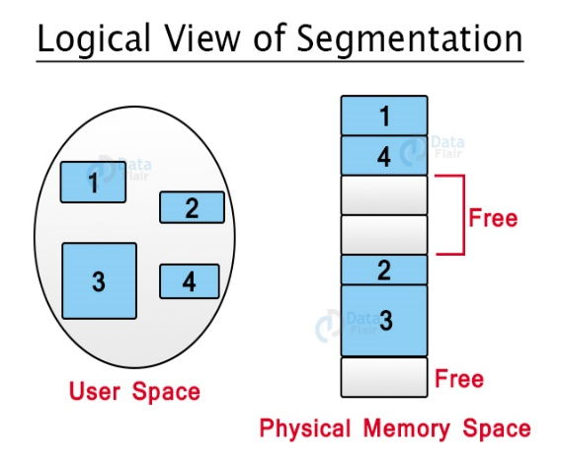
07 | Segmentation
Segmentation is similar to paging, except that the length of segments is variable and pages have a fixed size.
Variable-Length Segments
Each segment corresponds to a logical unit: main function, data structures, utility functions, stack.
Segment Map Table
The OS maintains a table with segment number, size, and base address in physical/virtual memory.
User-Visible Division
Unlike paging, the user defines segments — code, data, stack are each a separate segment.
Logical View of Segmentation
External Fragmentation
Paging vs Segmentation
Since segments vary in size, free memory may become fragmented into non-contiguous blocks.
Division: Paging=Fixed-size pages | Segmentation=Variable-size segments
Fragmentation: Paging=Internal | Segmentation=External

Slide 9
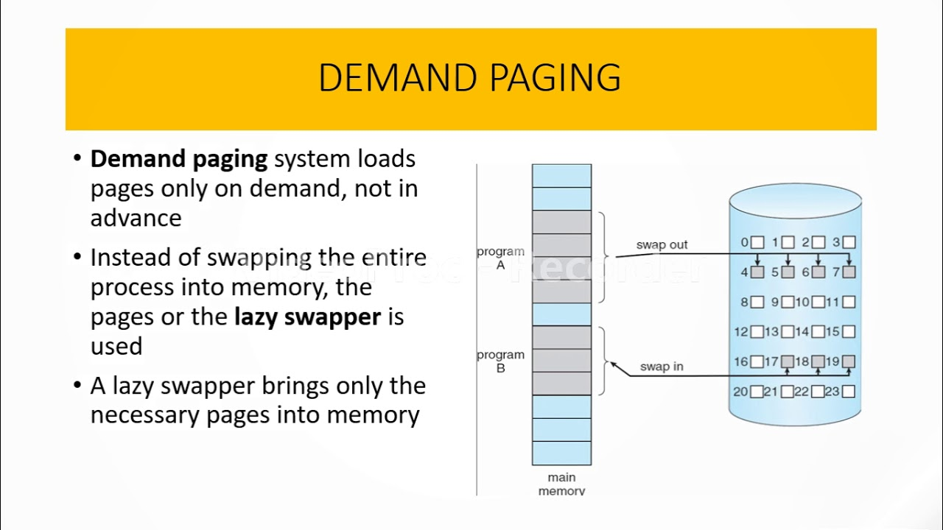
09 | Demand Paging
Key Concepts
Demand Paging
Pages loaded into RAM only when needed (on demand), not in advance. Reduces initial load time.
Lazy Swapper
Only the necessary pages are brought into memory — not the entire process at once.
Page Fault
Page Table Structure
If a required page is not in RAM, a page fault triggers the OS to load it from disk.
Valid Bit: 1 = page is in RAM; 0 = page is on disk (causes Page Fault)
Dirty Bit: 1 = page was modified; must be written back to disk before eviction

Slide 10
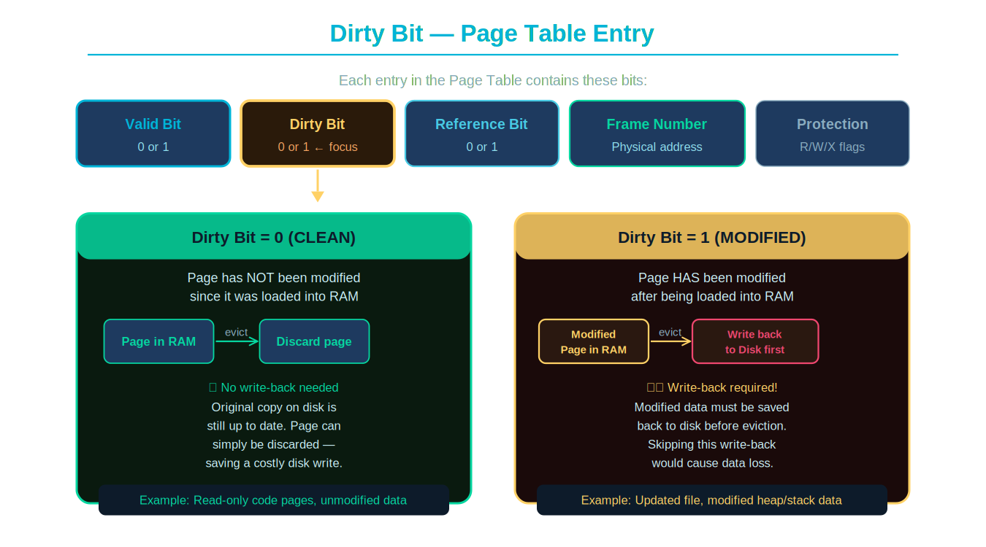
10 | Dirty Bit (Modified Bit)
The Dirty Bit is a flag in the Page Table Entry that tracks whether a page has been modified (written to) since it was loaded into RAM.
Notes:
Dirty Bit = 0 means the page is clean — disk copy is still valid, so the OS can simply discard it without writing back. Dirty Bit = 1 means the page was modified — the OS MUST write it back to disk before evicting it, or data will be lost.

Slide 11
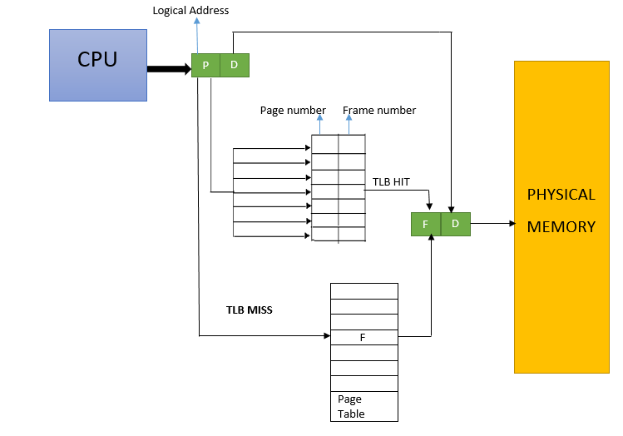
11 | TLB — Translation Lookaside Buffer
A TLB is a fast hardware cache inside the CPU that stores recent Page Table entries to speed up virtual-to-physical address translation.
✅ TLB HIT
Virtual address found in TLB → frame number retrieved instantly → access Physical Memory directly.
❌ TLB MISS
Not found in TLB → OS walks full Page Table → result cached in TLB for future access.
⚡ TLB Performance
Typical size: 64–1024 entries. Hit rates above 98% common. Dramatically reduces address translation overhead.
CPU → TLB → Physical Memory Translation

Slide 12
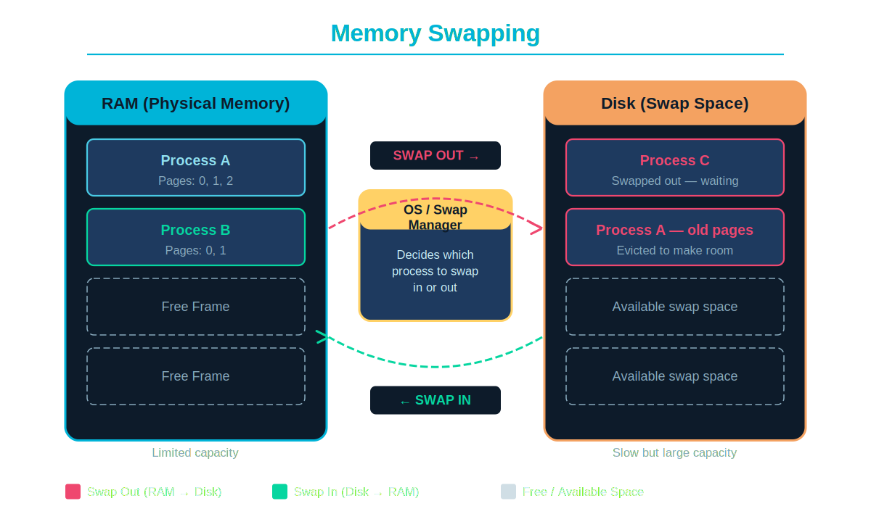
12 | Swapping
Swapping is when the OS moves an entire process or its pages between RAM and disk to free up memory for other processes.
Key Points
Swap Out
When RAM is full, OS moves a process's pages from RAM → Disk to free space.
Swap In
When process resumes, its pages load back from Disk → RAM for execution.
Swap Space
A dedicated disk partition or file reserved as overflow storage for RAM.
Performance
Necessary for multitasking but slow — disk I/O is far slower than RAM access.

Slide 13
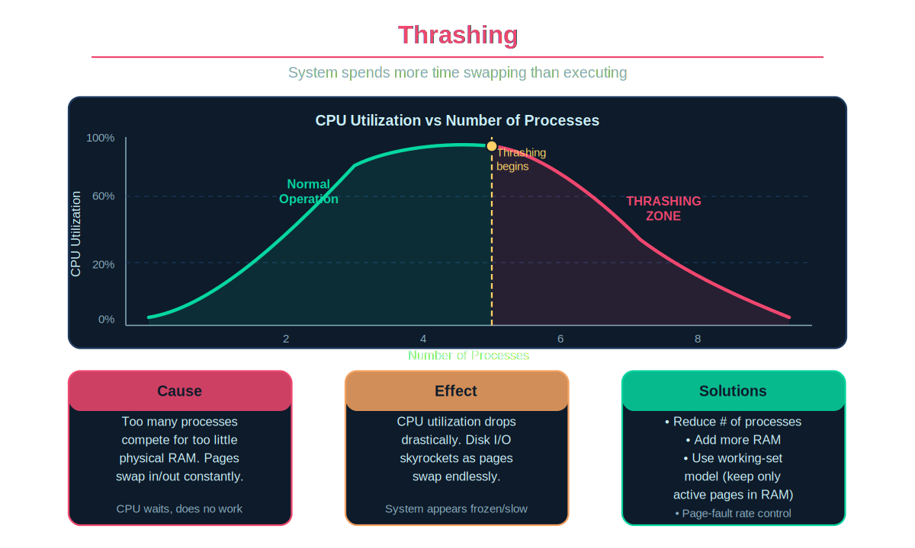
13 | Thrashing
What is Thrashing?
System spends more time swapping pages in/out than actually executing processes.
Cause
Too many processes compete for too little RAM. Every process needs pages the other holds.
Effect
CPU utilization crashes. Disk I/O skyrockets. System feels frozen or extremely slow.
Solutions
Reduce processes, add more RAM, or apply working-set model — keep only active pages in RAM.

Slide 14
Thank You!
Topics: Memory • Memory Management • Types • Virtual Memory • Paging • Segmentation • Demand Paging • TLB • Swapping • Thrashing

